Slide 1



Smart Contract Security
Souhail MSSASSI

Slide 2

Who Am I
MSSASSI Souhail
Offensive Security Engineer @Halborn
Security Consultant
Instructor at EatTheBlocks
OWASP Member
https://www.linkedin.com/in/mssassi/
https://fb.com/mssassii
souhail.mssassi@owasp.org

Slide 3

Agenda
1 – Introduction to Security
2 – Importance of Security In Smart Contracts
3 – Classical Attacks and Real Scenarios Hacks
4 – Best Practices and Security Patterns

Slide 4
Introduction to Security

Slide 5
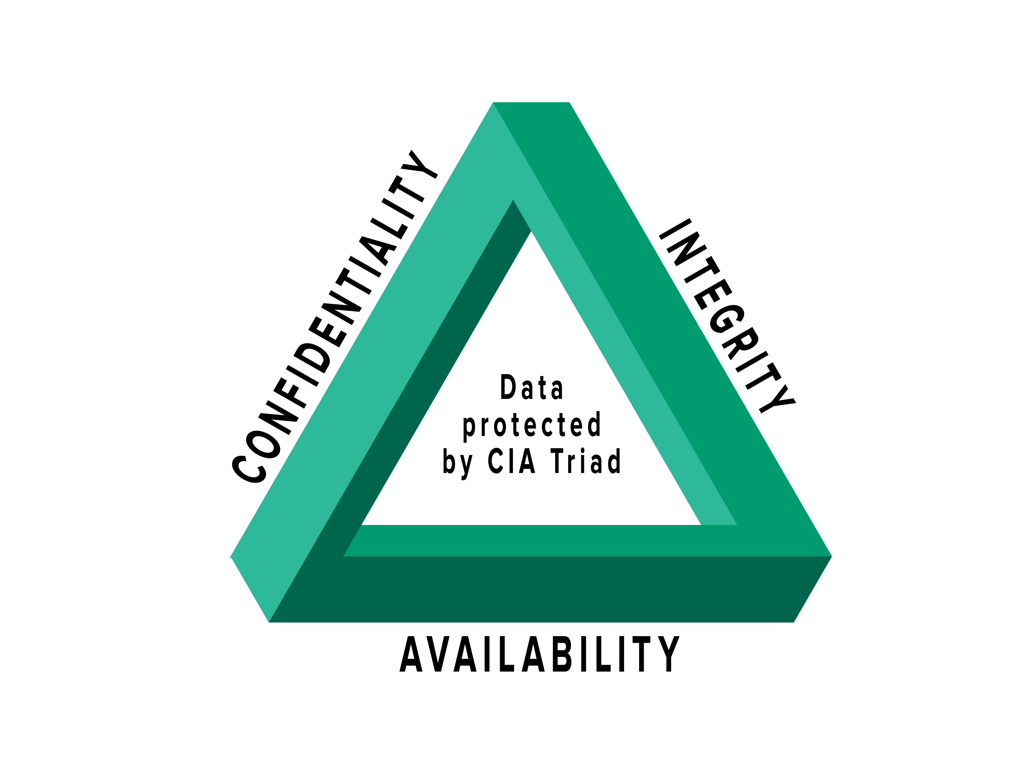
CyberSecurity
Integrity: i.e. guaranteeing that the data is what you think it is
Confidentiality: to ensure that only authorized persons have access to the resources exchanged;
Availability: to maintain the proper functioning of the information system

Slide 6
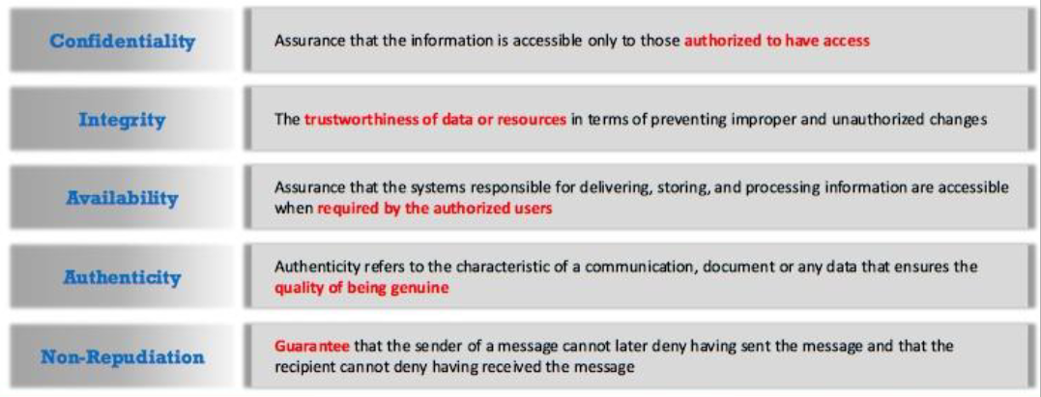
CyberSecurity

Slide 7
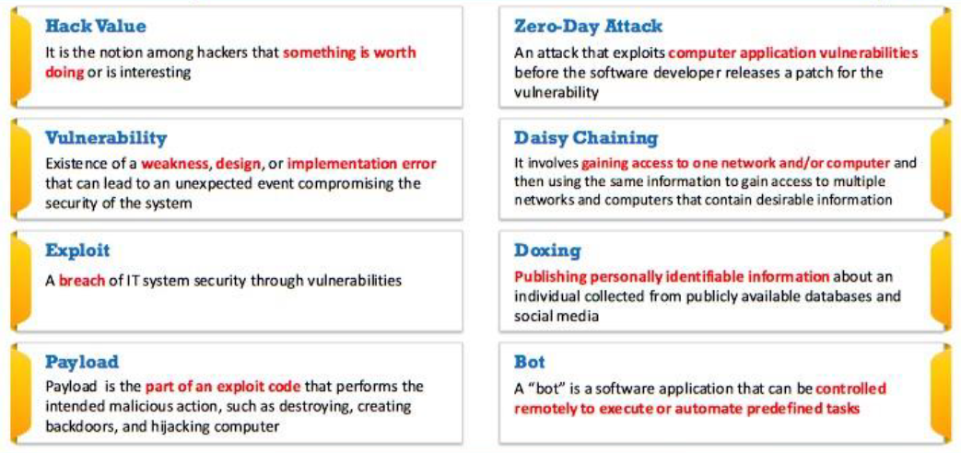
CyberSecurity

Slide 8
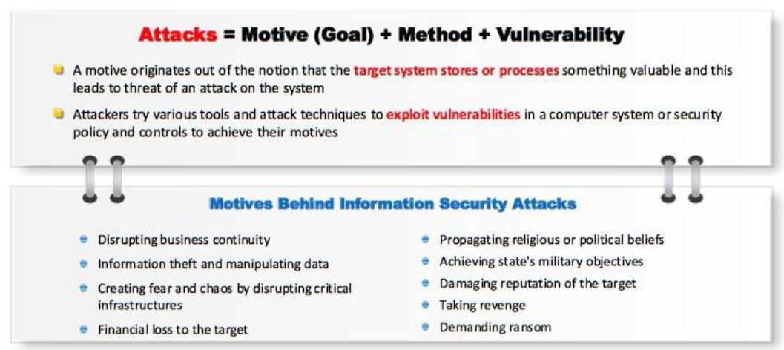
Motivation

Slide 9
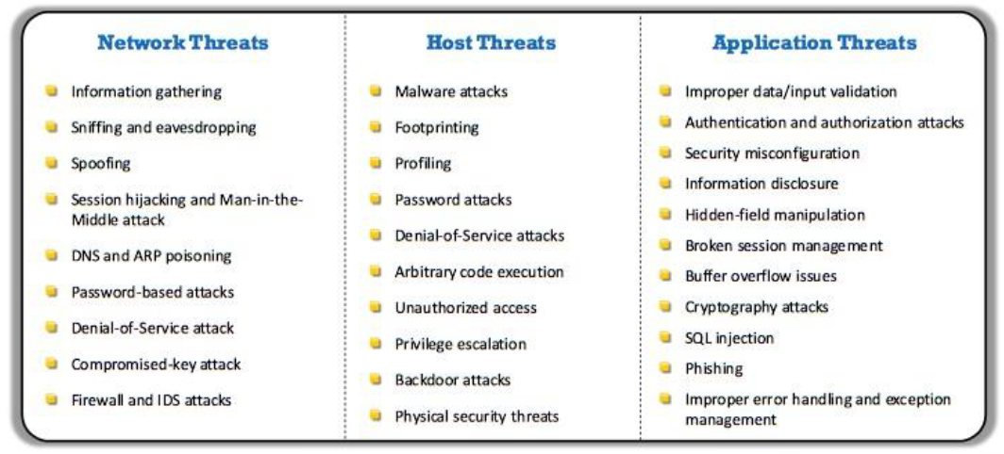
Threats

Slide 10
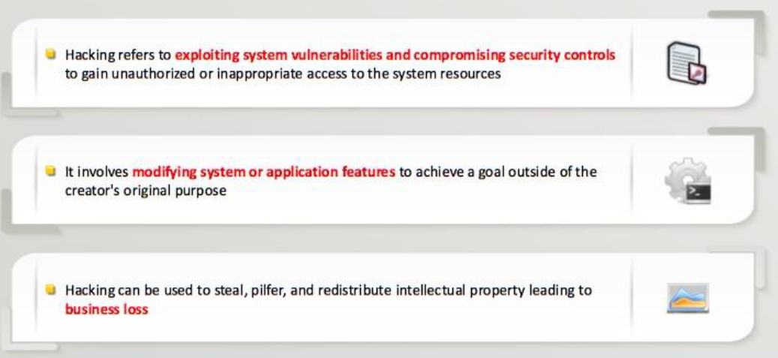
Hacking

Slide 11
Importance of Security In Smart Contracts

Slide 12
The need for a secure code
Ethereum and other complex blockchain systems are highly experimental.
Requires a new development philosophy
Unstable with a lot of potential to go wrong
People can drain millions of dollars from contracted accounts
«Disneyland for hackers»!

Slide 13
The difference?
Everything on a Blockchain is public! (code + data)
The blockchain can be considered as a server, where the server-side code is completely exposed to clients on the protocol (network nodes) and clients on DApps (users)
Big trade-off between Ethereum and Bitcoin -> Turing completeness of EVM
Attack surface is a problem on Ethereum

Slide 14
Patch problem
Smart contracts are immutable
Once deployed, bugs discovered cannot be fixed.
Must write robust code before deploying the core network
There is no built-in method to govern upgrading or self-destructing each person into a new instance once an exploit occurs. -
The future could be entire organizations governed by smart contract code

Slide 15
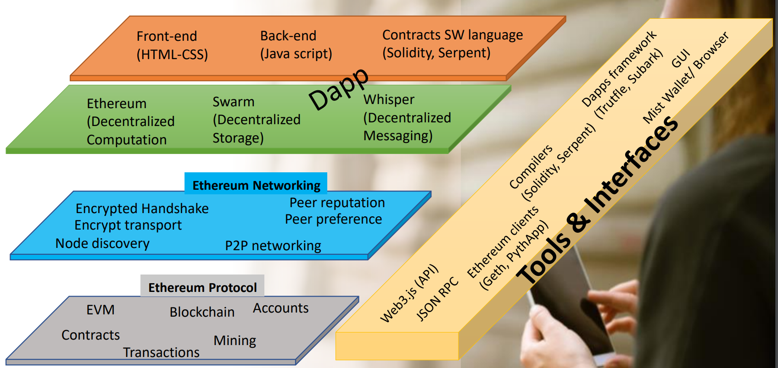
Composants Ethereum

Slide 16
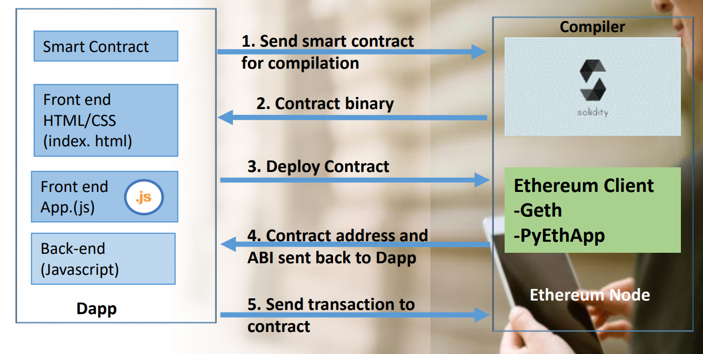
The flow of a dAPP

Slide 17
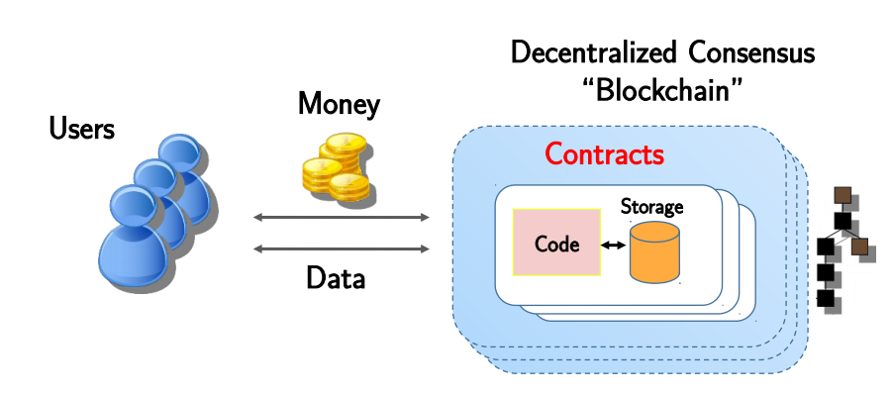
Processus - Solidity

Slide 18
Classical Attacks and Real Scenarios Hacks

Slide 19
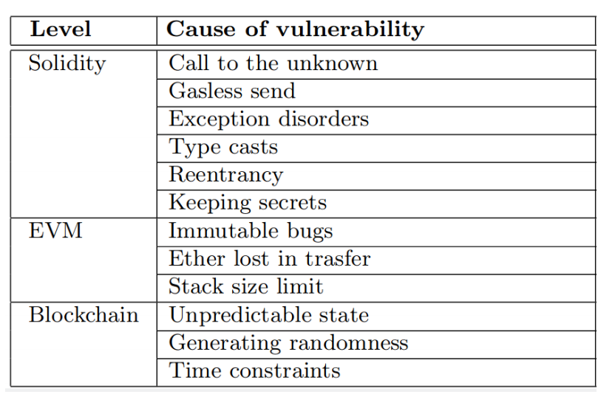
Weaknesses

Slide 20
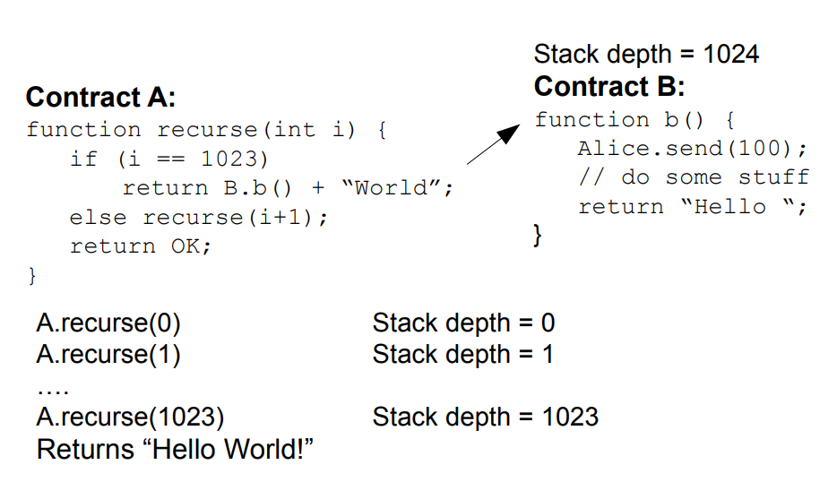
Limite of Stack
The maximum call stack depth is 1024
External function calls fail if they exceed the maximum call stack of 1024 and throw an exception.
The low-level functions send (), call (), callcode () and delegatecall () do not throw an exception but rather return false! -
Suppose we call A.recurse (0). Does Alice get 100?

Slide 21
Other weaknesses
Keeping secrets: declaring a field as private does not guarantee its confidentiality.
Since the blockchain is public, anyone can inspect the content of transactions and deduce the value of fields.
Immutable bugs: once a contract is published on the blockchain, it cannot be modified!
If a contract contains a bug, there is no direct way to fix it!
Ether lost in transfer: if ether is sent to an orphan address, it is lost forever
Programmers have to manually check the correctness of the recipients' addresses

Slide 22
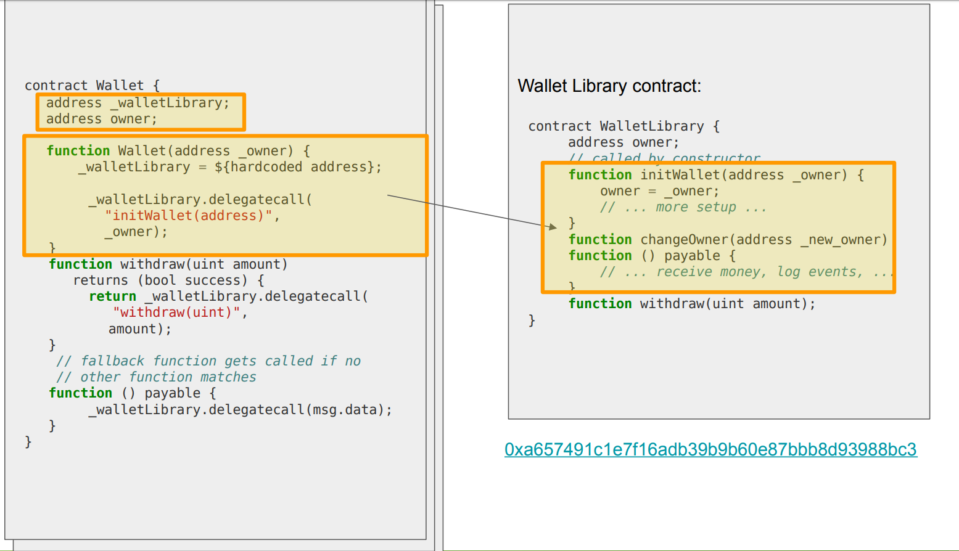
Constructor is called, invokes initWallet

Slide 23
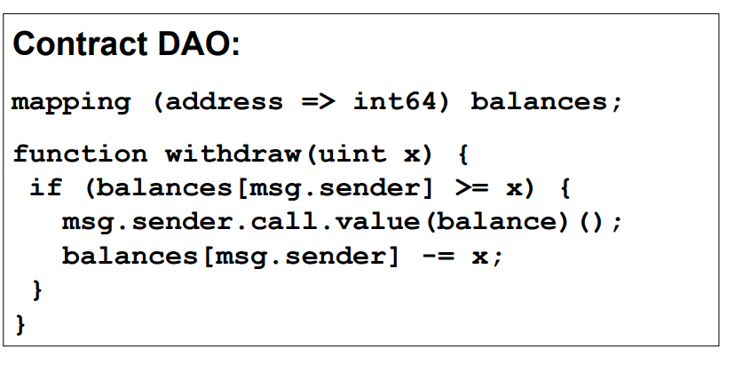
The DAO Attack
x

Slide 24
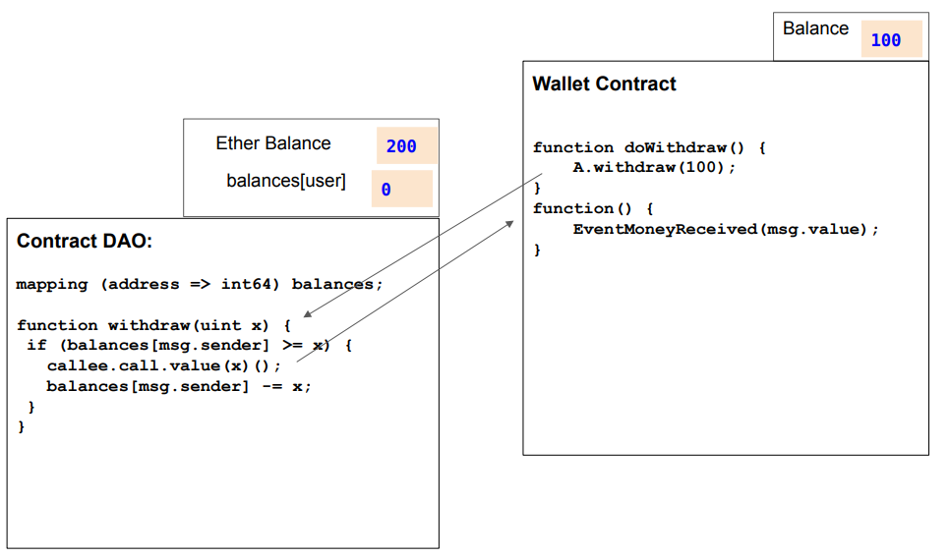
Re-entrancy Exploit

Slide 25
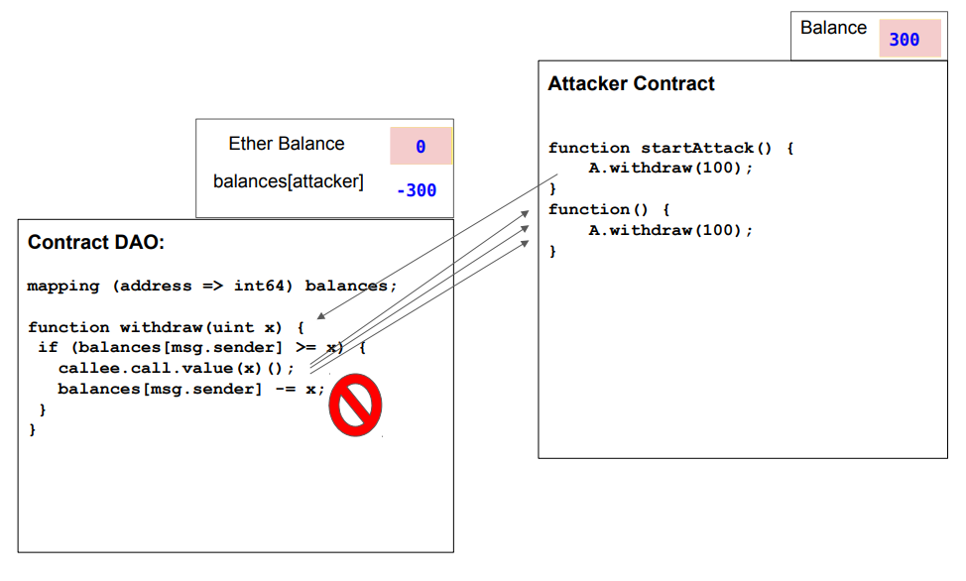
Re-entrancy Exploit

Slide 26
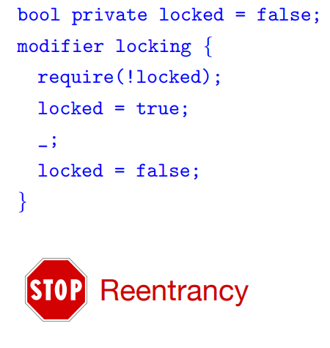
Re-entrancy Solution - Locking

Slide 27
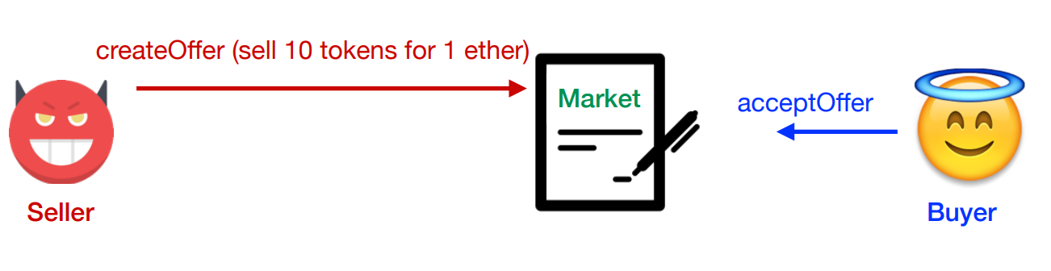
Transaction-Ordering Dependency
The order of execution of function calls cannot be predicted.
No prior knowledge of the state of a contract during the execution of the call

Slide 28
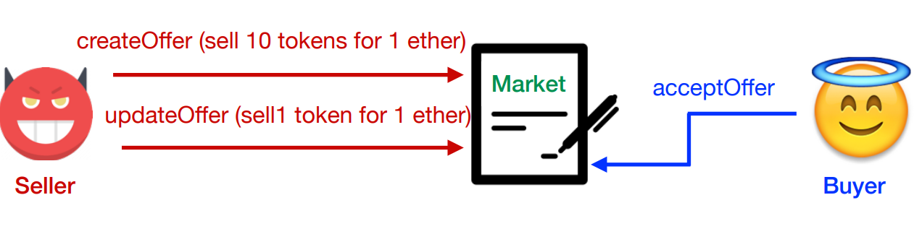
Transaction-Ordering Dependency
The order of execution of function calls cannot be predicted.
No prior knowledge of the state of a contract during the execution of the call

Slide 29
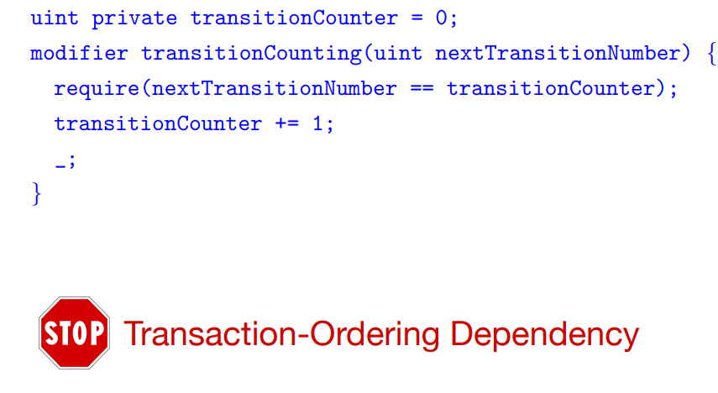
Transaction-Ordering Dependency – Transaction Counter

Slide 30
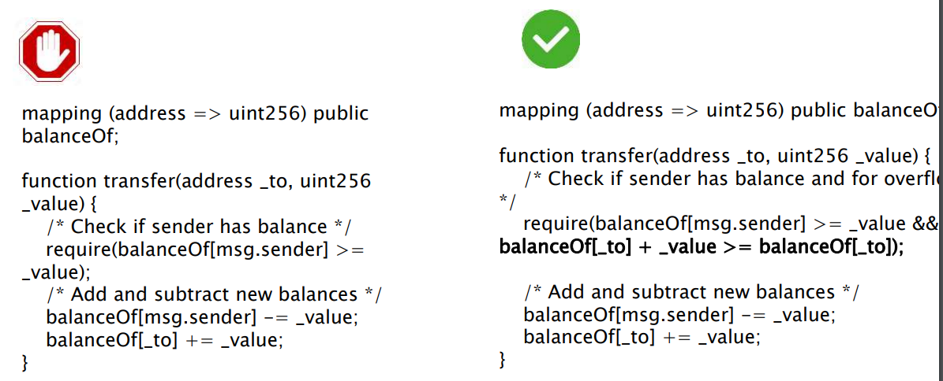
INTEGER OVERFLOW

Slide 31
Best Practices and Security Patterns

Slide 32
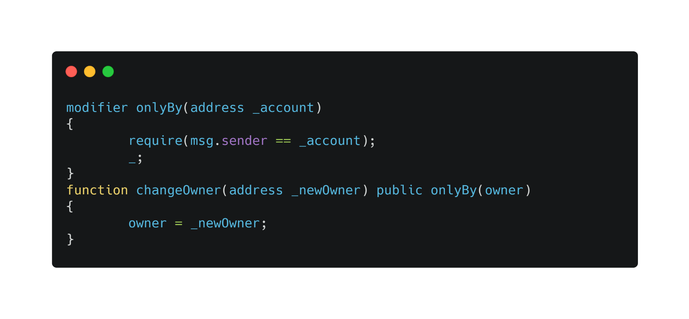
Security Patterns
Access Restrictions
Intention
To restrict access to contract features based on appropriate criteria.
Applicability
Use the Access Restrictions template when
Your contract features should only be callable under certain circumstances.
You want to apply similar restrictions to multiple features.
You want to strengthen the security of your smart contract against unauthorized access.

Slide 33
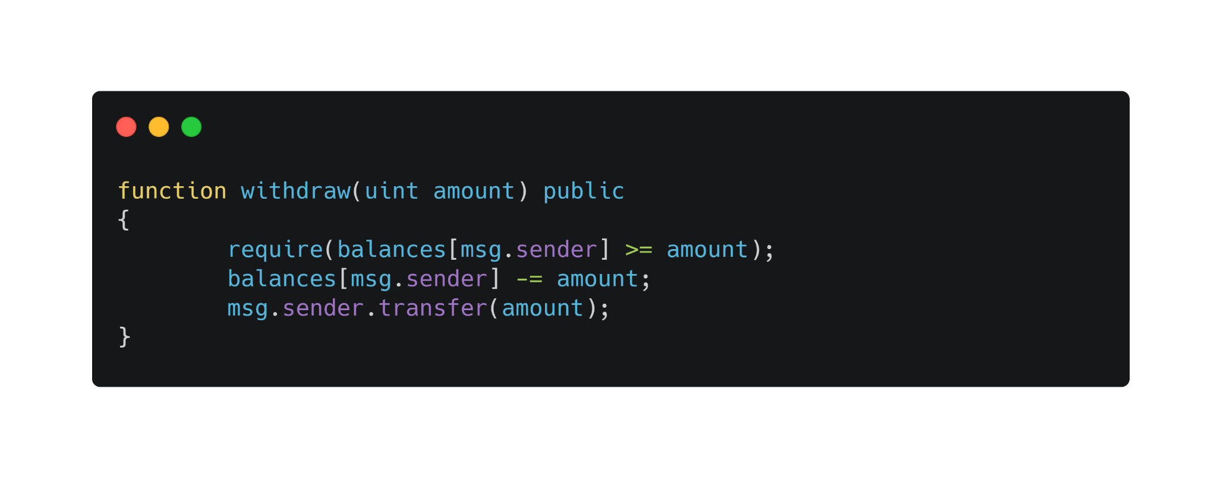
Security Patterns
Checks Effects Interactions
Intention
Reduce the attack surface of malicious contracts that attempt to hijack the control flow after an external call.
Applicability
Use the Checks Effects interaction model when
You cannot avoid handing over control flow to an external entity.
You want to protect your functions from reentry attacks.

Slide 34
Security Patterns
Pull over Push
Intention
Transfer the risk associated with ether transfer to the user.
Applicability
Use the Pull over Push model when
you want to manage multiple ether transfers with a single function call.
you want to avoid taking the risk associated with ether transfers.
your users are encouraged to manage the ether withdrawal themselves.

Slide 35
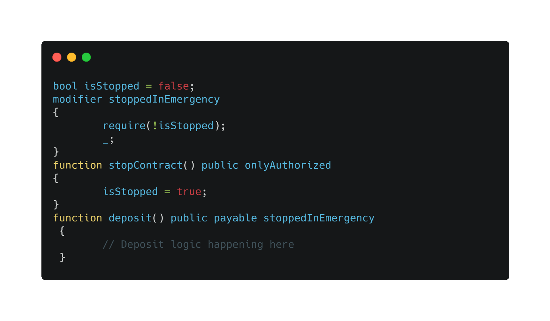
Security Patterns
Emergency Stop
Intention
Add an option to disable the emergency critical contract feature.
Applicability
Use the emergency stop template when
You want the ability to suspend your contract.
You want to protect critical functionality from abuse by undiscovered bugs.
You want to prepare your contract for potential failures.

Slide 36
How to be safe
Don't write fancy code
Use audited and tested code
Keep contracts simple
More complexity => More attack vectors
Keep up to date with software and the community -
Write as many unit tests as possible
Prepare for failure at any time, in any contract or method
Deploy carefully
Bugs bounties -
Beware of blockchain properties and weaknesses discussed -
For example. public vs. private, .send () vs. .call () vs. .transfer () -
Avoid external calls (to an unapproved contract or account) where possible

Slide 37

DEMO
https://remix.ethereum.org/

Slide 38
Questions ?
https://www.linkedin.com/in/mssassi/
https://fb.com/mssassii
souhail.mssassi@owasp.org

Slide 39
Thanks
https://www.linkedin.com/in/mssassi/
https://fb.com/mssassii
souhail.mssassi@owasp.org

